Slide 1

Speed Dating Predictions Team 3B : Urvi Vaidya (vaidyau@uci.edu) Nishant Parate (nparate@uci.edu) Sem Leontev (sleontev@uci.edu) Soo Lee (sool10@uci.edu) Dandan Zhou (dandanz1@uci.edu)

Slide 2

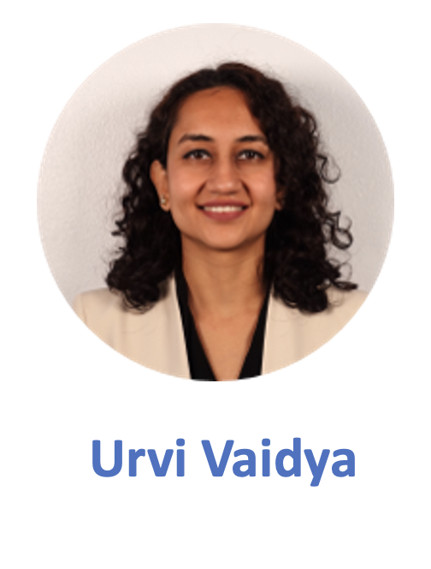
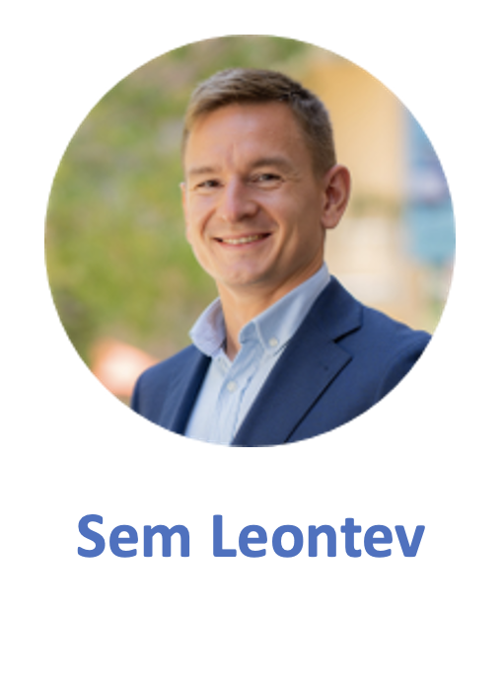
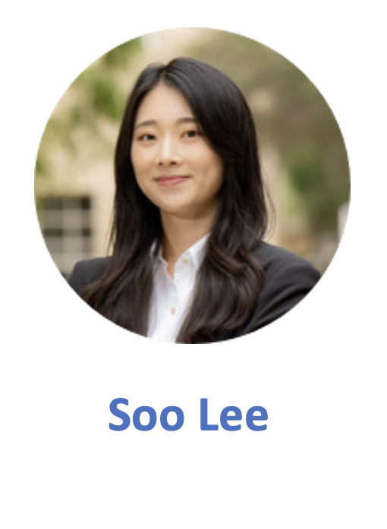

THE TEAM
Dandan Zhou
D

Slide 3
Business Idea : Speed Dating Match Prediction.
Importance : We find this as an interesting topic since there are already serval dating apps that show potential matches based on individual needs, likes and dislikes. It will also give us insight into human behaviour and understand what factors are important to people when it comes to choosing potential mates.
Data Resources: For this project we are using a dataset that was compiled by Columbia Business School professors Ray Fisman and Sheena Iyengar for their paper Gender Differences in Mate Selection: Evidence From a Speed Dating Experiment.
As part of their study the subjects were asked to fill a survey when they signed up for the Speed Dating Event and fill a scorecard on various attributes on each of their potential matches. At the end of the night subjects were matched with potential partners if both persons said yes. This experiment was conducted on various days with different groups of people and collated into one dataset.
Our goal is to predict the result of matching as "Yes" or "No"

Slide 4
Some Information About our Data
84 attributes and 1 target(match) column​
76 columns with null values and 7 object type columns. ​
We will eventually drop columns with more than 20% missing values and fill the remaining null values with the mean of the column and create dummy variables using one hot encoding in Data Processing Part I.​

Slide 5
Gender Differences in Views & Perception
The Participants were asked to distribute 100 points across the below attributes in response to each question.

Slide 6
The participants view of their own attributes.
All this information was collected from the participants as part of the signing up process before the event.
The participants chose to match or not with the person they met at the end of their 4-minute speed date.

Slide 7
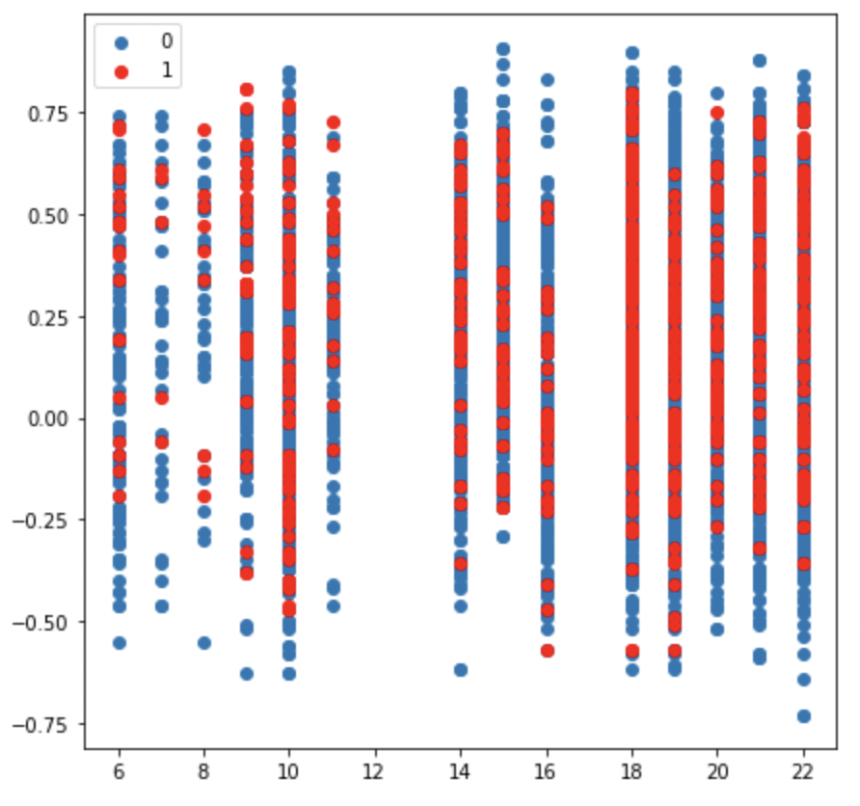
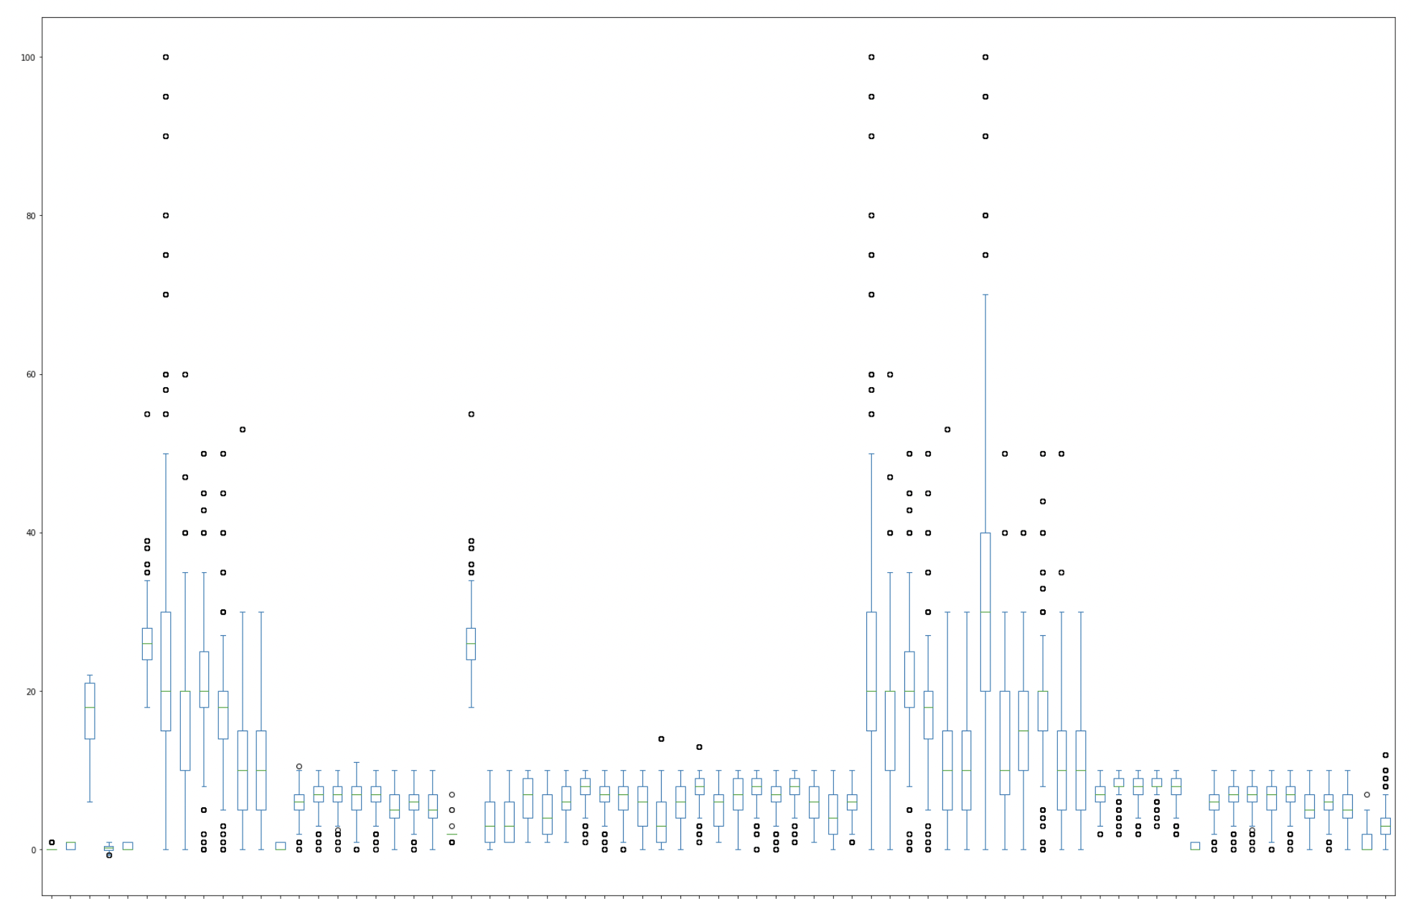
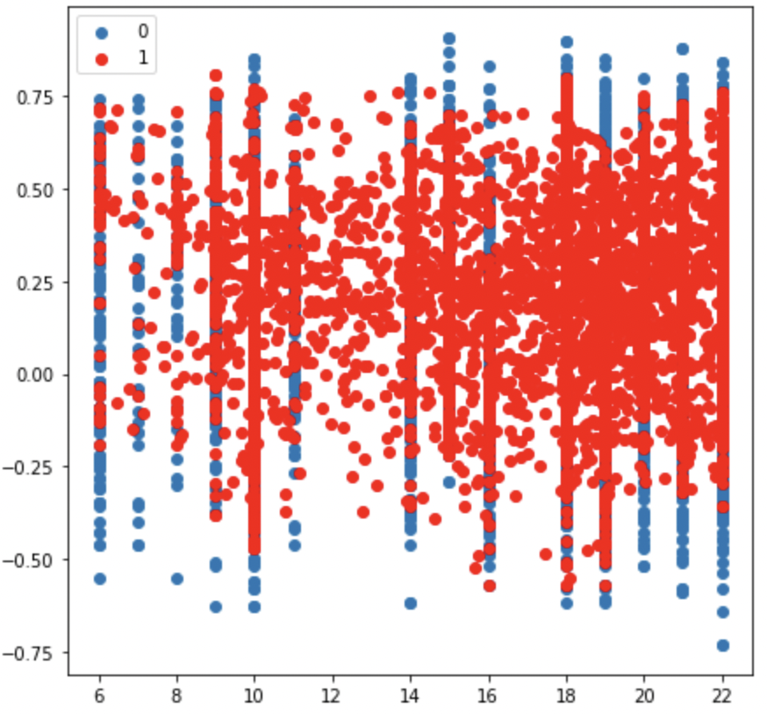
Having explored our data we then checked for any outliers that could cause our model to be overfit and/or underperform.
After Dealing with the outliers using Isolation Forest we began the process of fitting our models and tuning them.
We have also resampled our data using Synthetic Minority Oversampling Technique (SMOTE)
Data Processing Part II

Slide 8
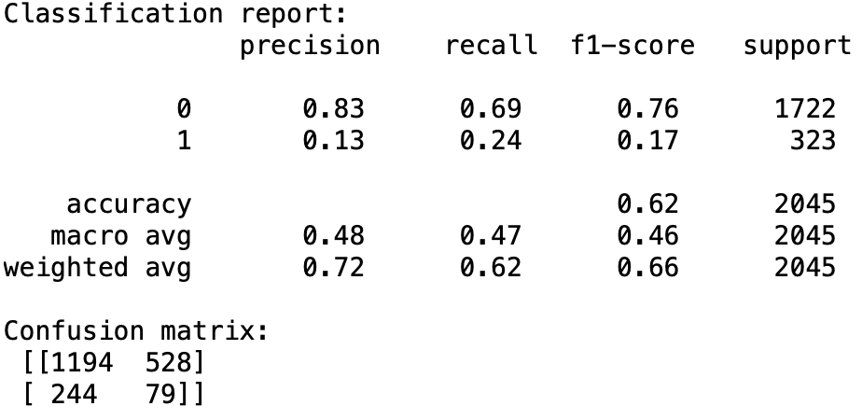
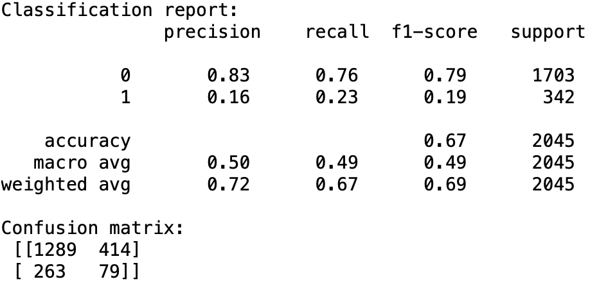
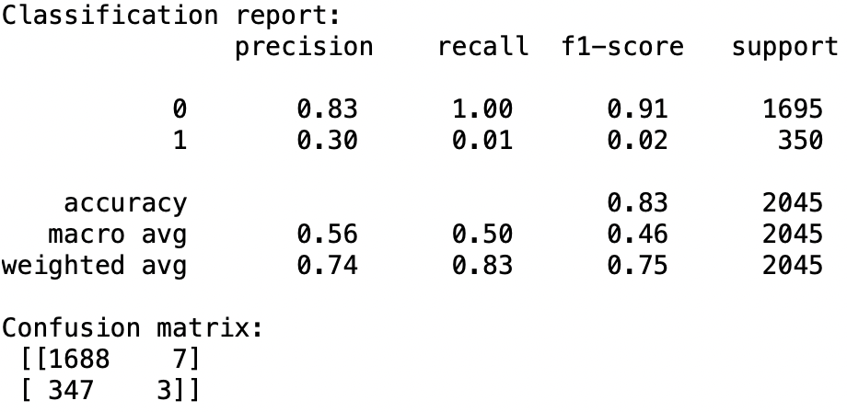
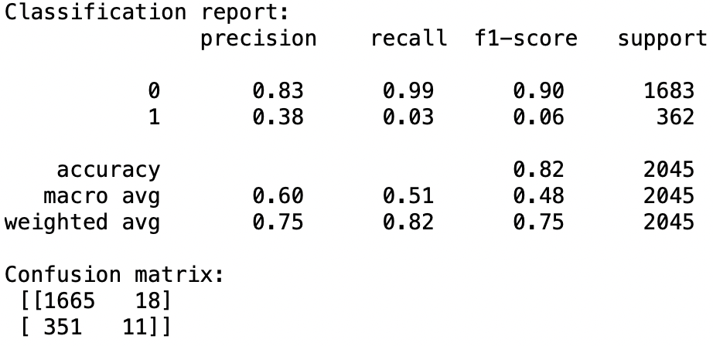
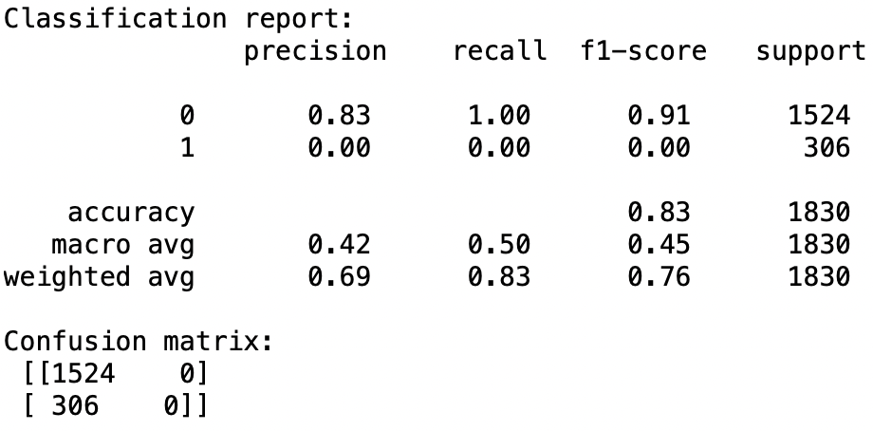

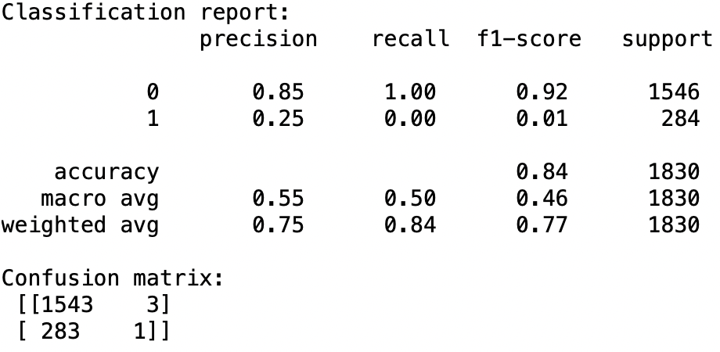
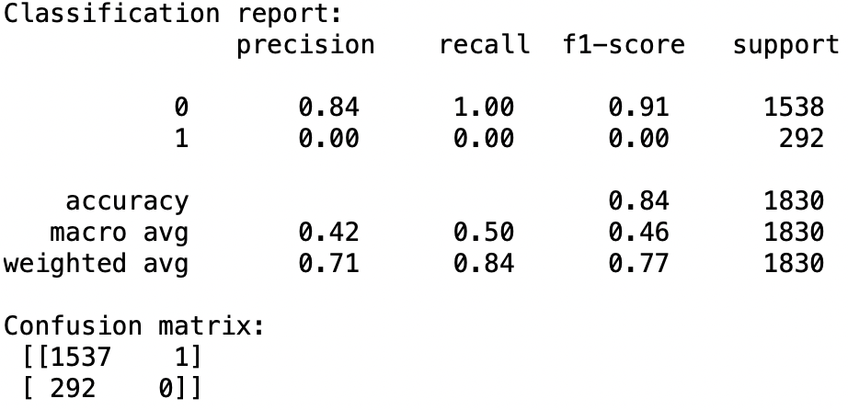
Principal Component Analysis Results
Logistic Regression | Decision Tree Classifier | Naïve Bayes Classifier | KNN Classifier

Slide 9
Our Process
We used four machine learning models to classify our data into match and no match. We ran each of our models using four versions of our data to get the best model and accuracy.
Decision Trees Classifier
Naïve Bayes Classifier
Logistic Regression
K Nearest Neighbors
Benchmark Data : This data is the original dataset in which we have not dropped any columns or rows.
Cleaned & Processed Data : In this set we dropped columns and rows with logically and those with large volumes of null values( 20% & above) and treated our dataset for outliers.
Resampled Data : We resampled our dataset using Synthetic Minority Oversampling Technique (SMOTE)
Data using Extra Trees Classifier as a feature selection method : Using this method we got the top 12 attributes which we then used for our machine learning models.

Slide 10
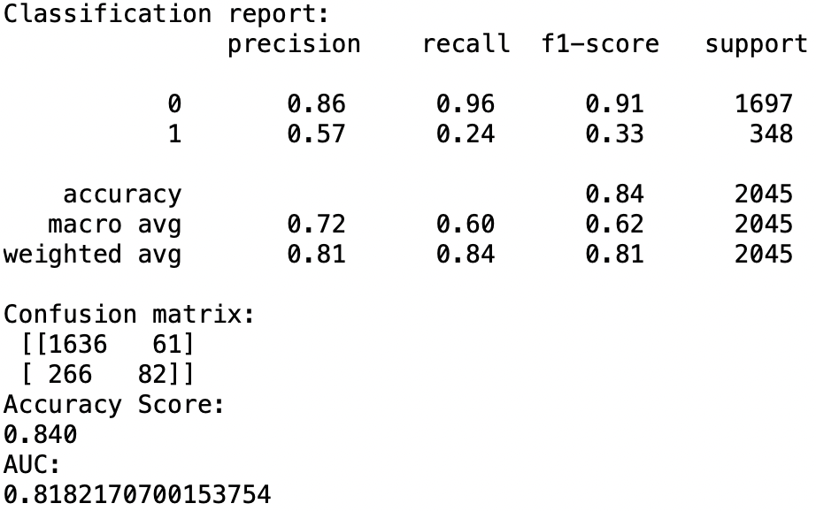
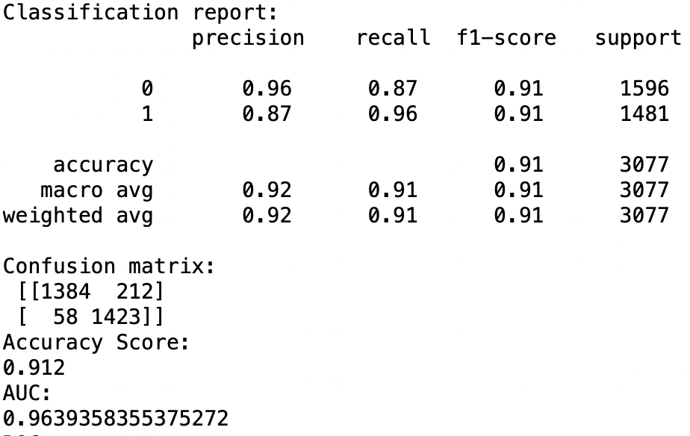
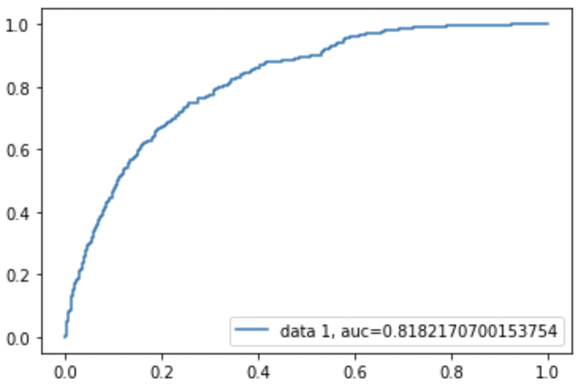
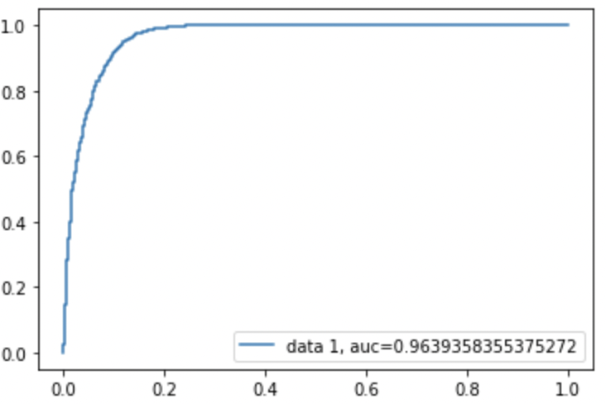
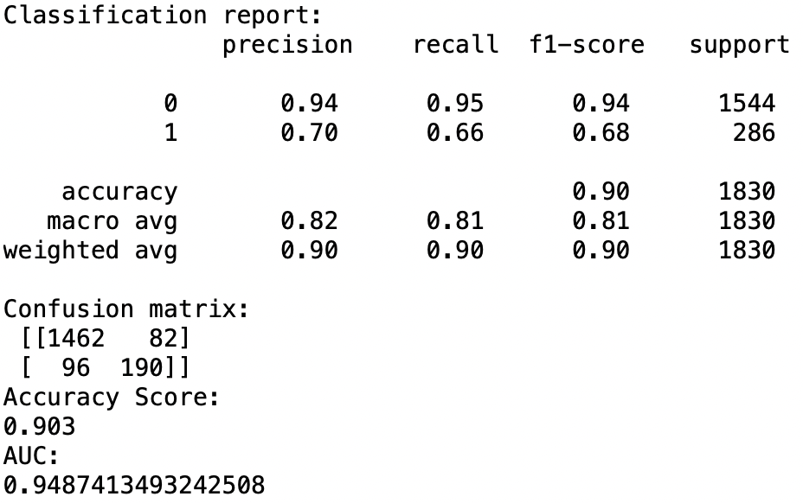
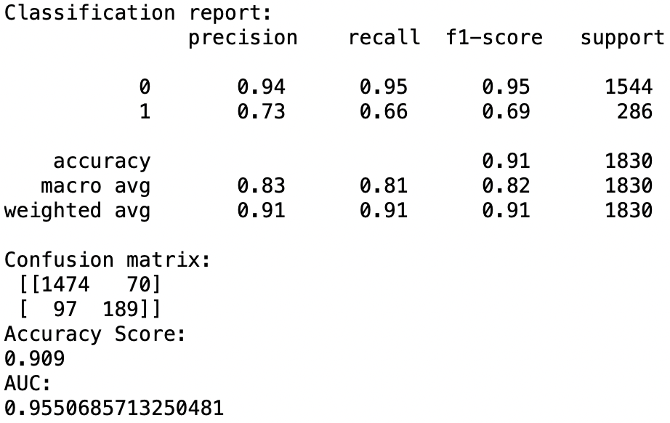
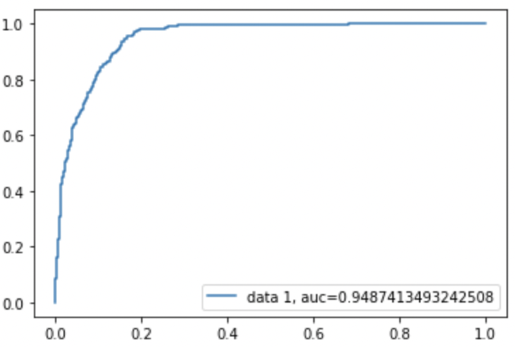
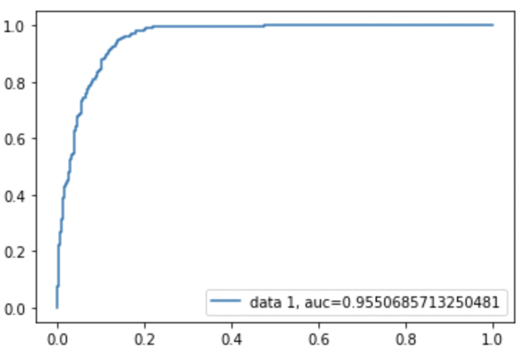
Logistic Regression Results
BENCHMARK RESULTS | RESAMPLED DATA
CLEANED PROCESSED DATA | DATA SUBSET USING EXTRA TREES CLASSIFIER

Slide 11
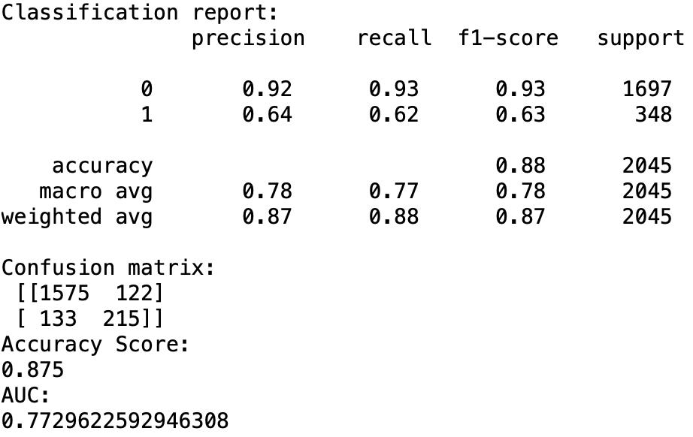
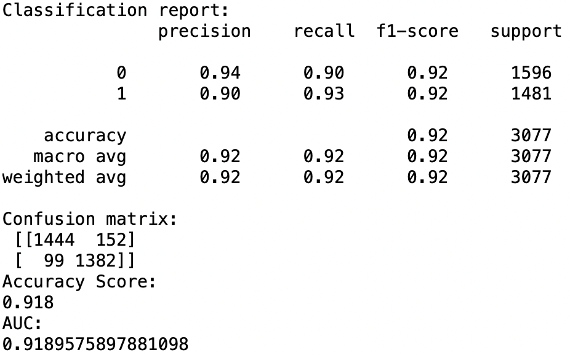
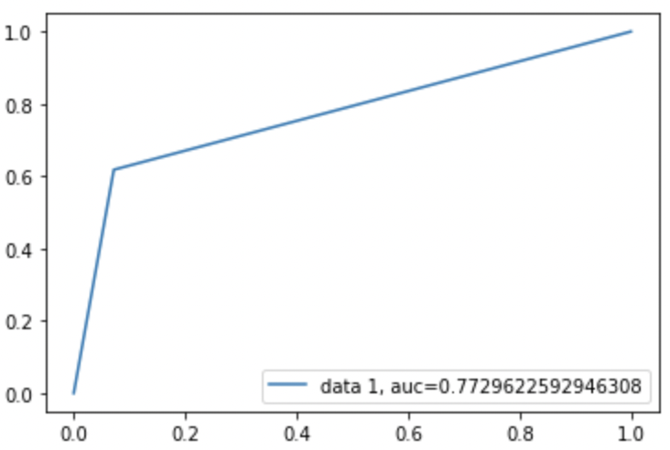
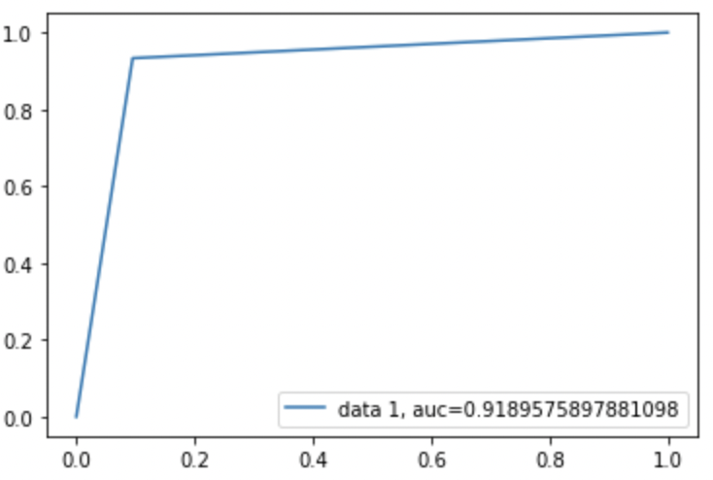
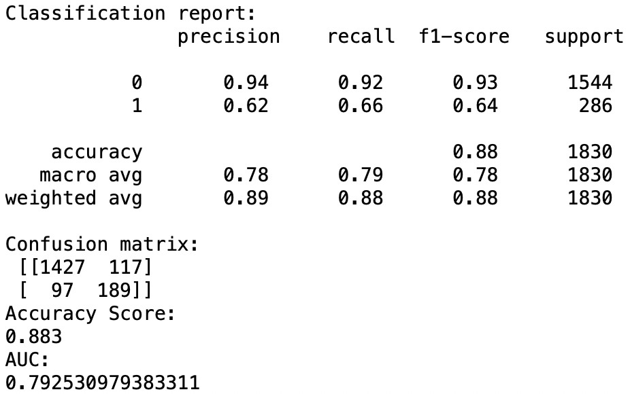
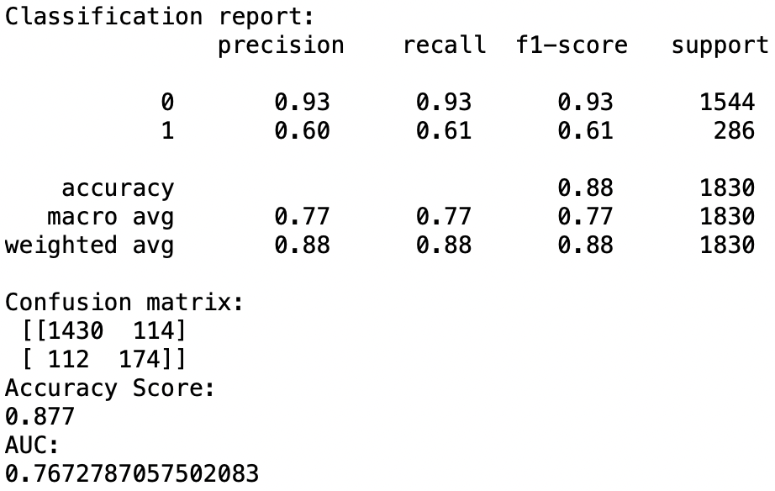
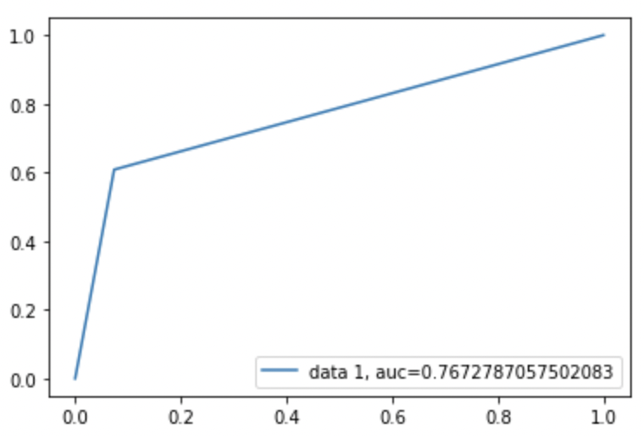
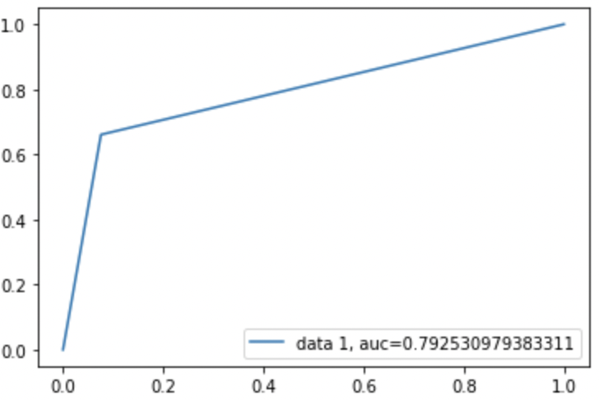
Decision Trees Classifier Results
BENCHMARK RESULTS | RESAMPLED DATA
CLEANED PROCESSED DATA | DATA SUBSET USING EXTRA TREES CLASSIFIER

Slide 12
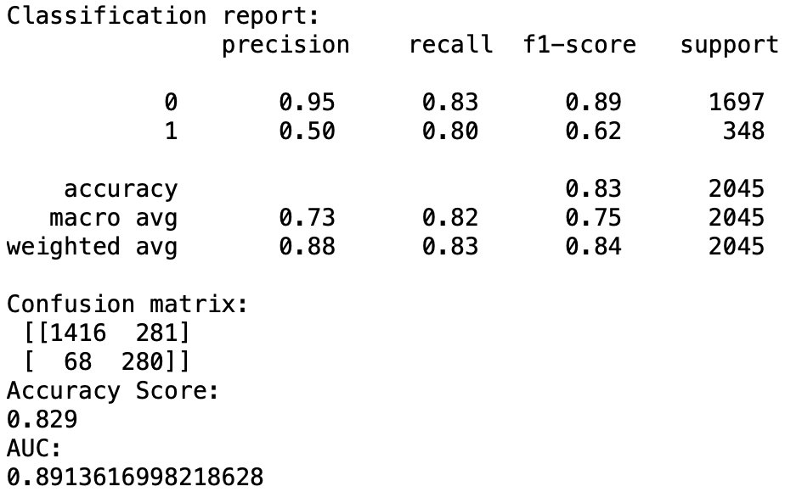
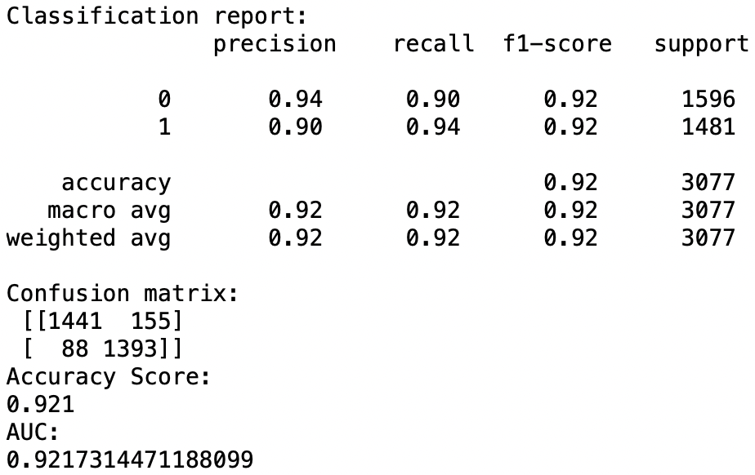
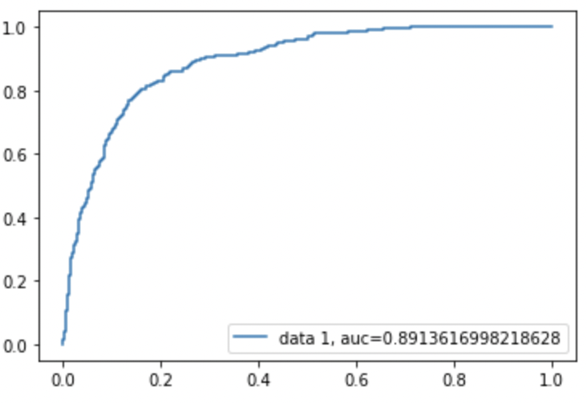
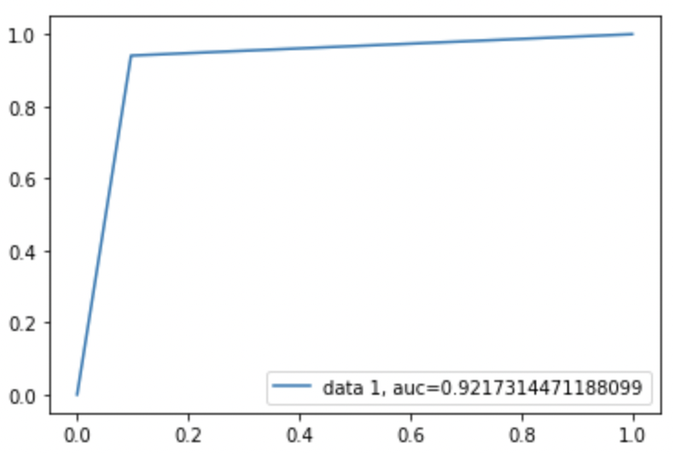

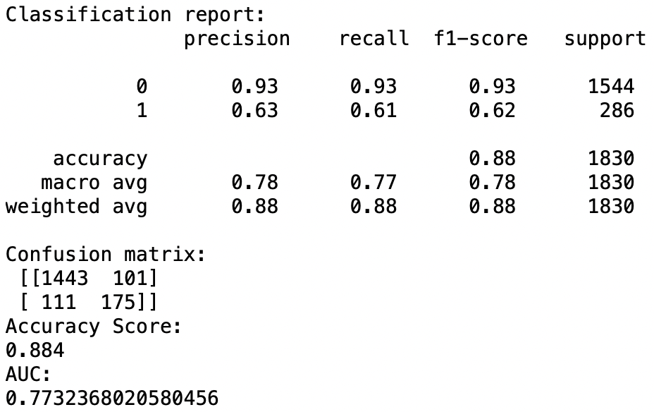
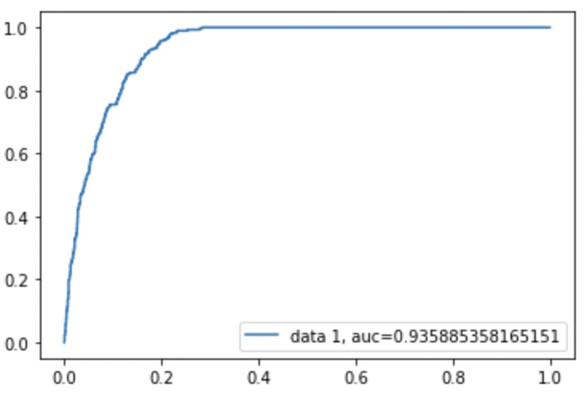
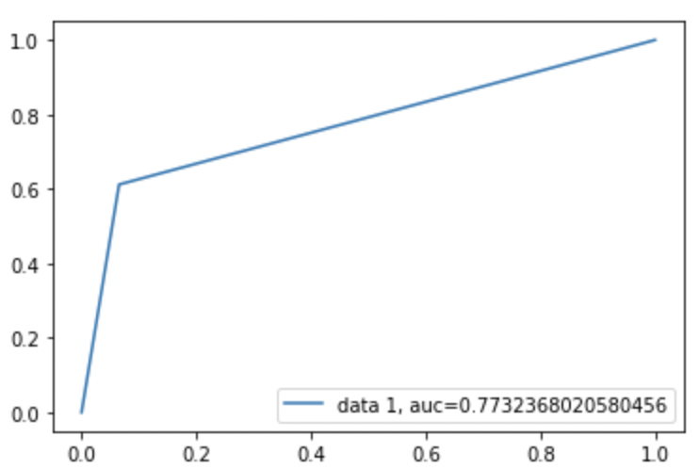
Naïve Bayes Classifier Results
BENCHMARK RESULTS | RESAMPLED DATA
CLEANED PROCESSED DATA | DATA SUBSET USING EXTRA TREES CLASSIFIER

Slide 13


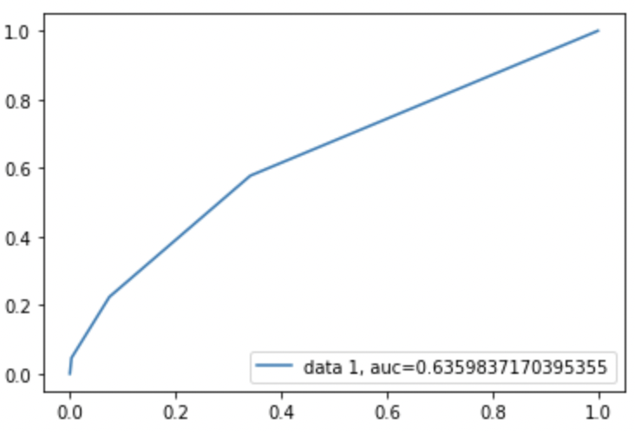
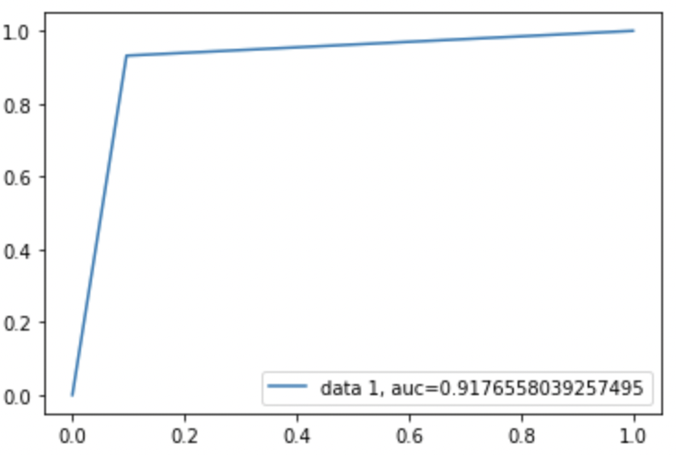



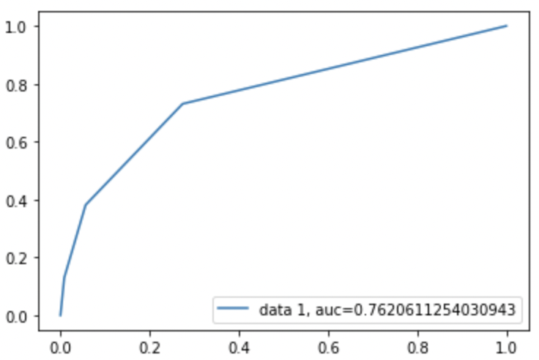
K Nearest Neighbors Results (K-3 & K=7)
BENCHMARK RESULTS | RESAMPLED DATA
CLEANED PROCESSED DATA | DATA SUBSET USING EXTRA TREES CLASSIFIER

Slide 14
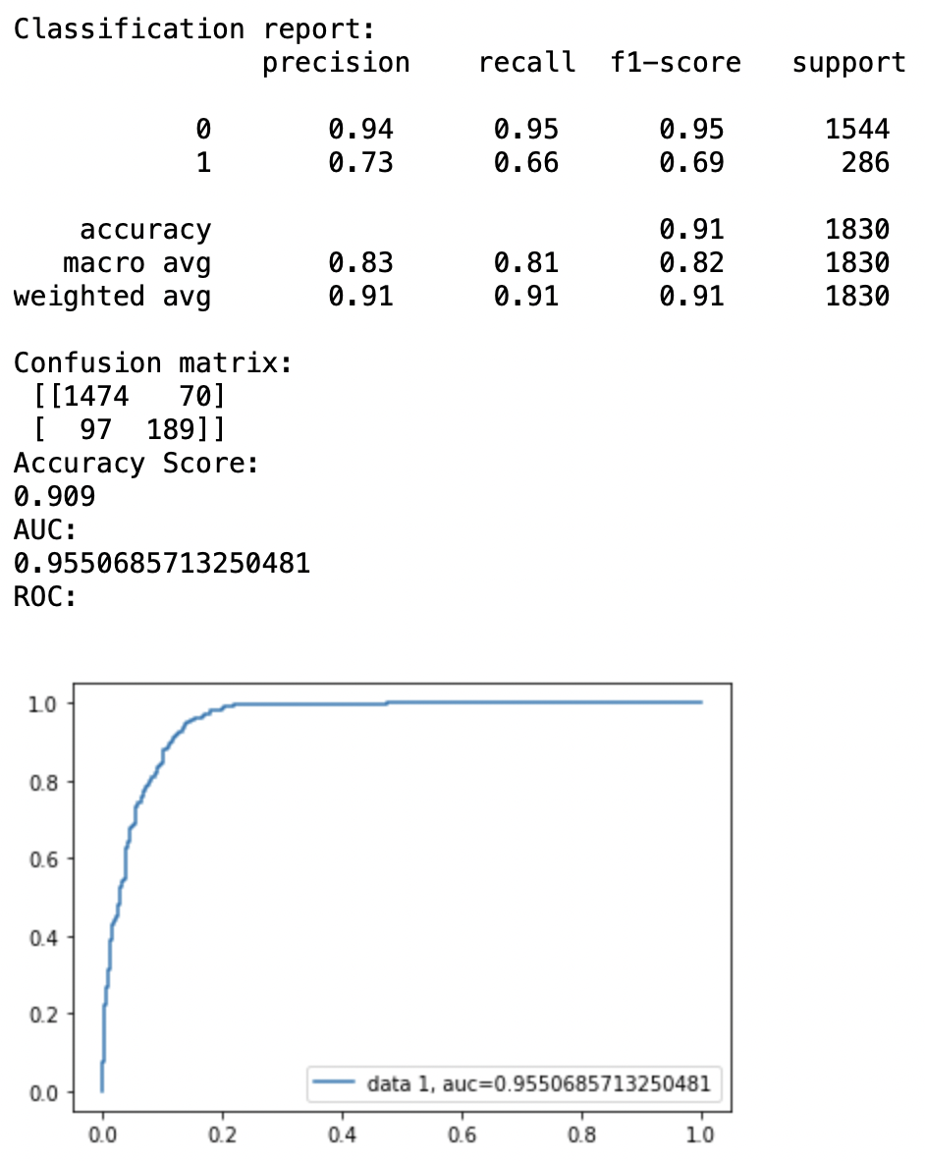
Selected Model & Results
Winning Model : Logistic regression
Winning Dataset : Data Subset Using decision trees Classifier
Top features :
'int_corr’ : correlation between participant’s and partner’s ratings of interests
'age_o’ : age of partner
'pf_o_att’ , 'pf_o_int’, 'pf_o_fun’, 'pf_o_amb’, 'pf_o_sha’ :
Partner’s stated preference for attraction, intelligence, fun, ambition, shared interest
'attr_o’, 'sinc_o’, 'intel_o’, 'fun_o’, 'amb_o’, 'shar_o’ :
Rating by partner the night of the event, for attraction, intelligence, fun, ambition, shared interest
'like_o’ : partners rating of like
'dec’ : decision of participant
'attr’ : attractiveness of partner
'intel', 'fun', 'amb', 'shar', 'like’ : Participants rating on intelligence, fun, ambition, shared interest and like
'prob’ : How probable do you think it is that this person will say 'yes' for you

Slide 15
Q & A

